Slide 1
Khaled Majzoub - DSBA - Module 5 - Tableau
File created on: 9/18/2020 7:19:39 PM

Slide 2
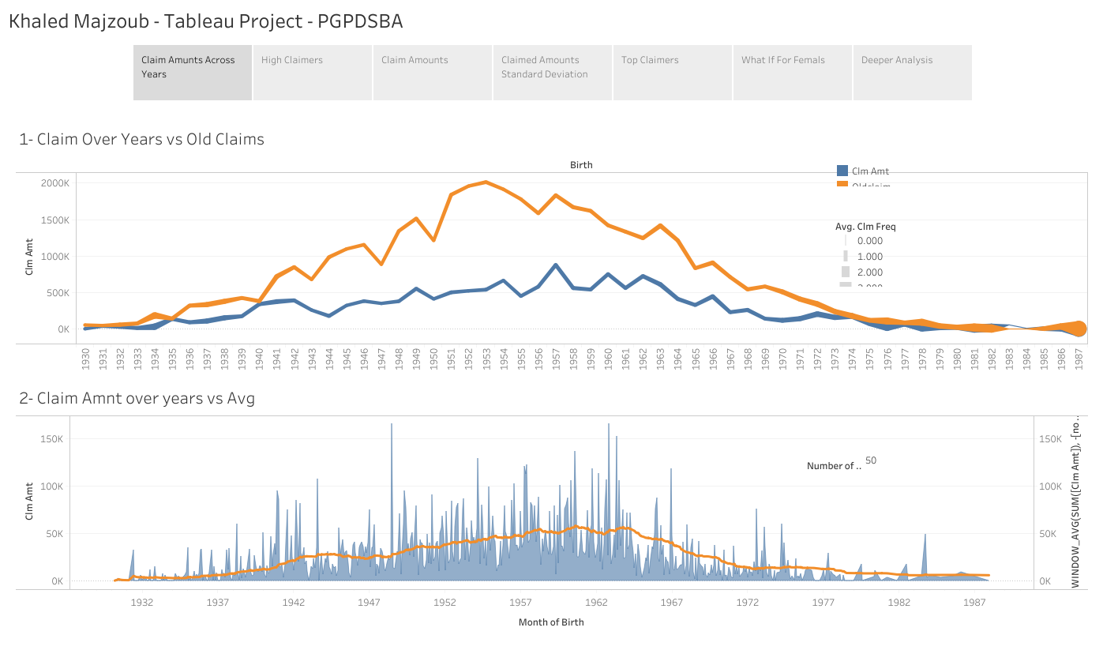

Slide 3
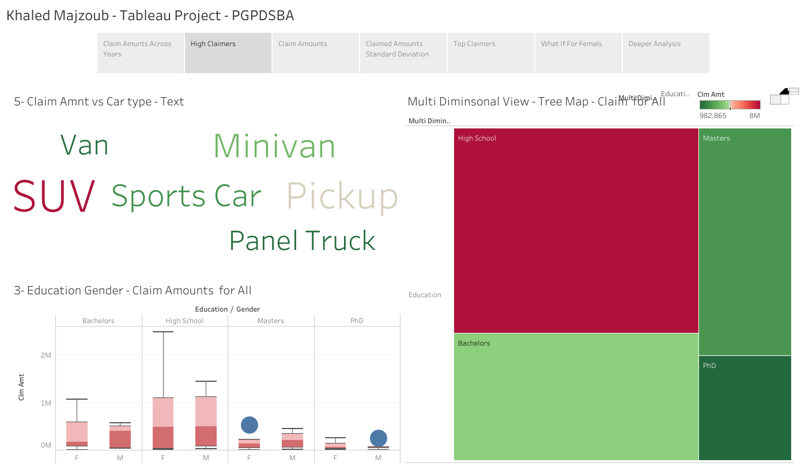

Slide 4
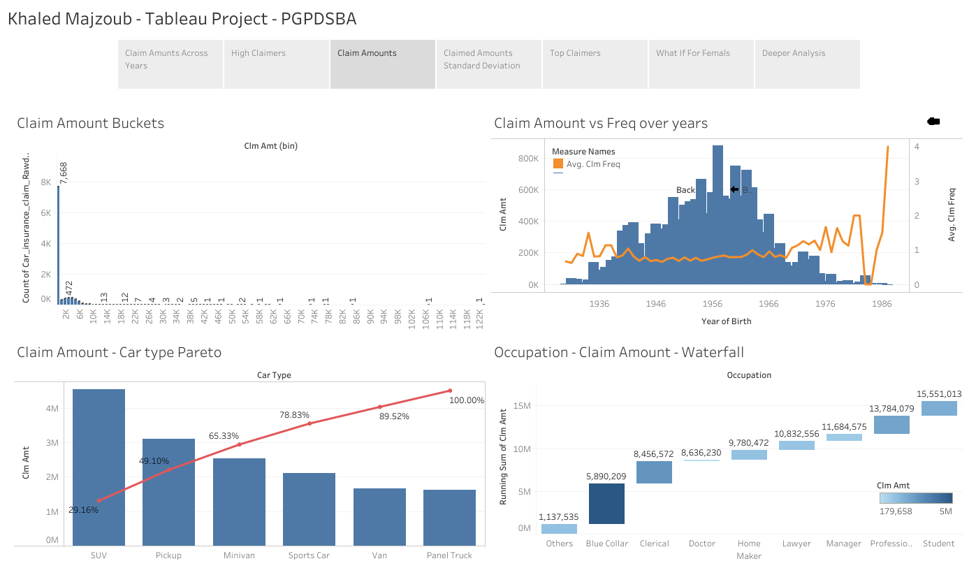

Slide 5
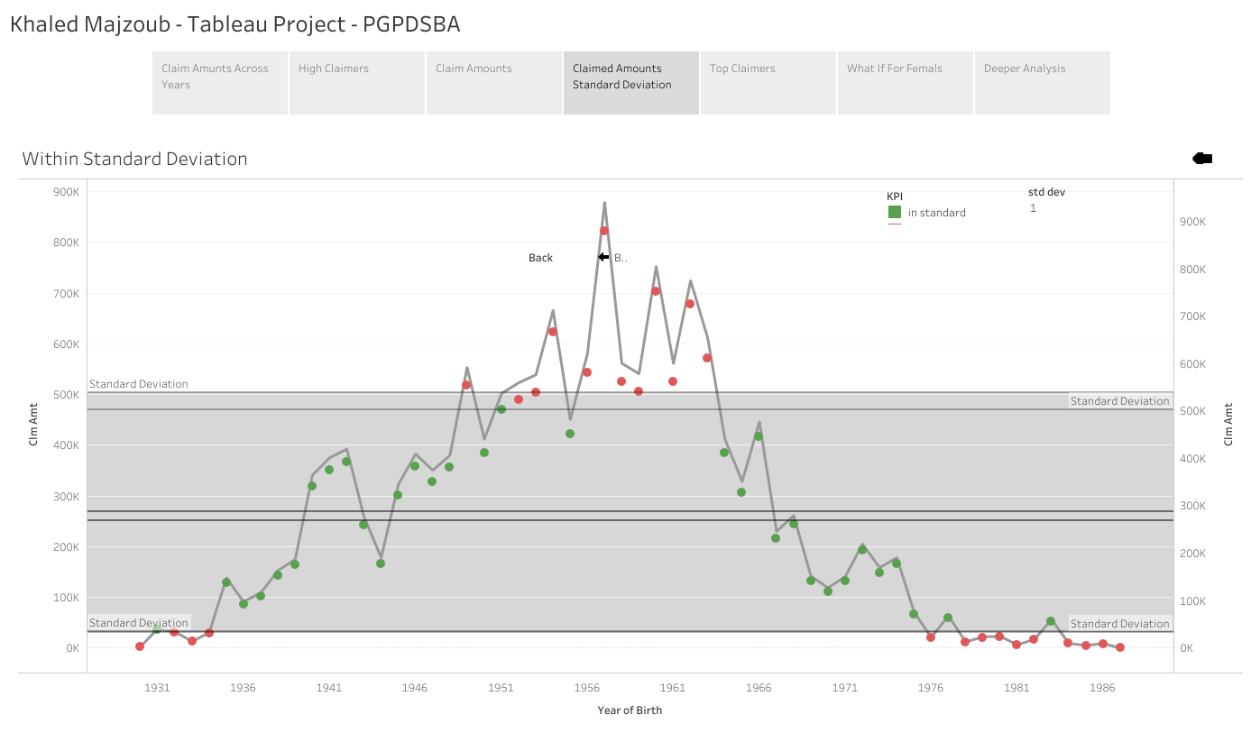

Slide 6
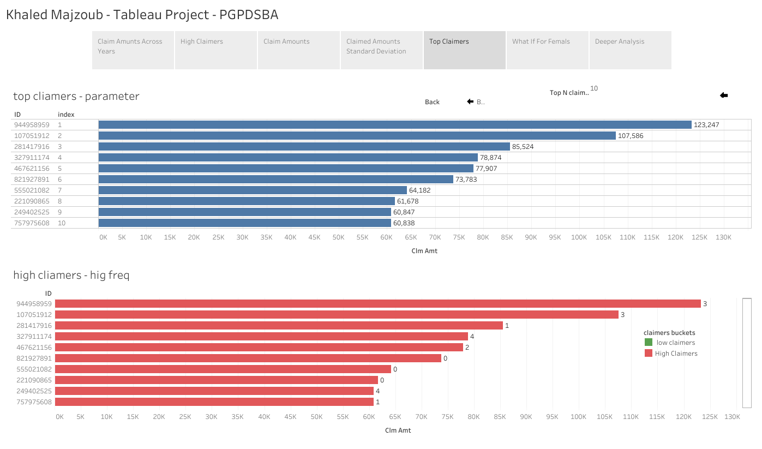

Slide 7
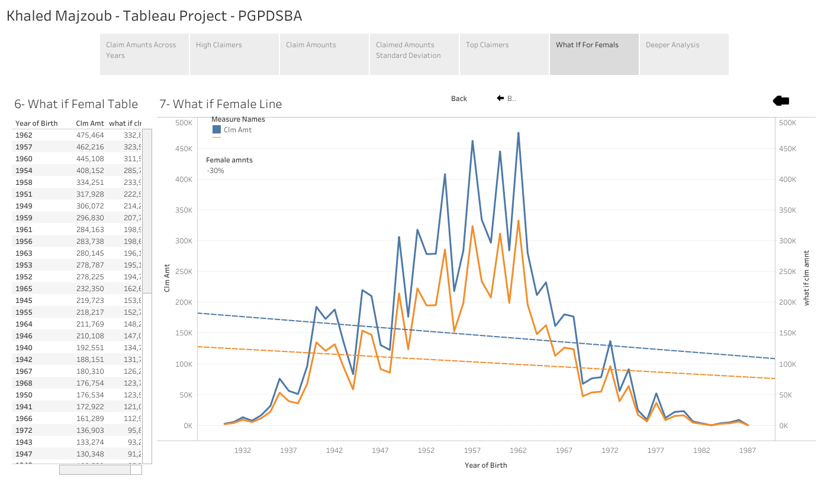

Slide 8
